Slide 1
Modern Microarchitecture and Future Directions
EE382N.1 Lecture 26
Dam Sunwoo
Arm Research
The University of Texas at Austin

Slide 2
Reminders
How was the guest lecture on Machine Learning?
Lab 6
Due Dec 12 (Wednesday), 11:59pm
Final Exam
December 14 (Friday), 7-10pm
ECJ 1.214 (NOT OUR USUAL CLASSROOM)
Grad Lab
Due Dec 17 (Monday), 11:59pm

Slide 3
Modern Microarchitecture

Slide 4
Trace Cache (Intel Pentium 4)
[Rotenberg+, MICRO 1996]
MICRO Test of Time Award in 2015
Cache that stores dynamic stream of instructions (trace)
Increases instruction fetch bandwidth (less breaks)

Slide 5
Micro-operation Cache (MOP/uOP Cache)
[Solomon+, ISLPED 2001]
Store uops of decoded instructions
No need to decode again if found in the uop cache
Supposedly used in Intel Sandy Bridge and successive microarchitectures and AMD Zen
[Anandtech]

Slide 6
Reprise: Two-Level Branch Prediction
[Yeh+, MICRO 1991]
[Scott McFarling, 1993]
Branch history and branch address combined to index into Pattern History Table (PHT) of 2b saturating BPs
2b used to predict branch direction
When branch resolved, update 2b
PHT (2bc)
BHR
1
0
1
1
0
0
1
1
1
[GSHARE]

Slide 7
Perceptron Branch Predictor
[Jimenez+, HPCA 2001]
Perceptron: single-layer neural network
binary linear classifier
Applied to branch prediction
Alternative to two-bit counter

Slide 8
TAGE Branch Predictor
[Seznec+, JILP 2006]
(partially) TAgged GEometric history length branch prediction
Exponentially longer (folded) history for high-order tables
Cascaded structure gives priority to matches with longer history
Efficient usage of tables with combination of short and long histories
Only use long history when it matters

Slide 9
Data Prefetching
[Jouppi, ISCA 1990]
Regular patterns
Next-line
Stride
…
Jouppi’s “Stream Buffer”
Each stream buffer holds one stream of sequentially prefetched cache lines
Can have multiple streams
Can have prefetch storage separate from cache

Slide 10
Best-Offset (BO) Prefetcher
[Michaud, HPCA 2016]
Winner of DPC2 (2015)
Periodically train to find “best-offset” to prefetch from a given set of candidate offsets
433.milc
470.lbm
459.GemsFDTD
462.libquantum

Slide 11
Spatial Memory Streaming (SMS) Prefetcher
[Somogyi+, ISCA 2006]
Identify irregular spatial patterns to prefetch (many instances of same structure in data)
Patterns within region represented by bitvector

Slide 12
Markov Prefetcher
[Joseph+, ISCA 1997]
(figure from [Nesbit+, HPCA 2004])
Correlation-based Prefetching
Each table entry holds list of addresses that have immediately followed the current miss address in the past
Length of correlated streams can vary from two to several hundred
Large storage needed

Slide 13
Global History Buffer (GHB)
[Nesbit+, HPCA 2004]
Maintain large FIFO history buffer
Buffer can be too large to fit on-hip

Slide 14
Irregular Stream Buffer (ISB)
[Jain+, MICRO 2013]
Remap irregular address stream into sequential structural address space
Synchronize on-chip metadata based on TLB residency

Slide 15
Prefetcher Metrics / Parameters
Accuracy
Used prefetches / sent prefetches
Coverage
Prefetched misses / all misses
Timeliness
On-time prefetches / used prefetches
Traffic
Memory bandwidth consumed with prefetcher / without prefetcher
Prefetch distance (lookahead)
How for ahead of the demand stream
Prefetch degree
How many prefetches per demand access

Slide 16
Cache Replacement
LRU: Least Recently Used
RRIP: Re-reference Interval Prediction [Jaleel+, ISCA 2010]
SHiP: Signature-based Hit Predictor [Wu+, MICRO 2011]
Hawkeye: Learn per-PC cache behavior by applying Belady’s OPT on previous accesses [Jain+, ISCA 2016], Winner of CRC2 (2017)

Slide 17
Value Prediction
[Lipasti+, MICRO 1996]
MICRO Test of Time Award 2017
Predict data values within core
Speculatively breaks true data dependency to increase ILP in OOO cores
“branch prediction but for values”
Proposed by 4 independent groups in mid-90’s
AMD, Technion, CMU, Wisconsin
No known commercial implementation (yet)
Gaining some interest

Slide 18
Intel Nehalem (2008)
[source: Wikipedia]

Slide 19
Intel Skylake (2015)
[source: https://www.nextplatform.com/2017/08/04/drilling-xeon-skylake-architecture/ ]

Slide 20
Arm Cortex-A76 (2018)
[source: https://images.anandtech.com/galleries/6373/02_Cortex-A76%20Deep%20Dive%20Final_NoWM_12.png]

Slide 21
Future Directions

Slide 22
What have we learned?
From Lecture 1…

Slide 24
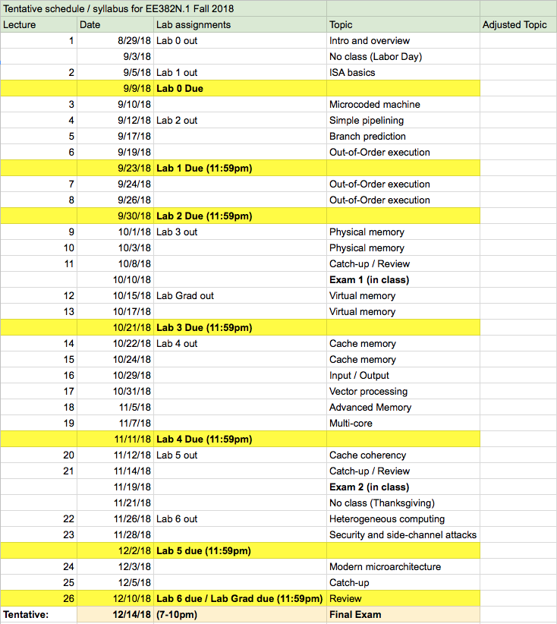
Course Schedule from Lecture 1
We covered all topics!

Slide 25
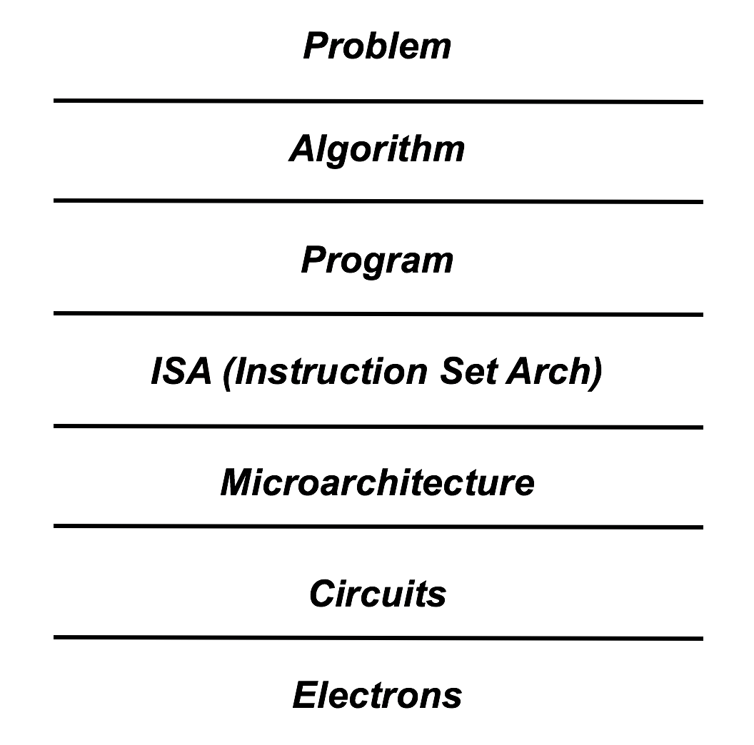
Back to the Abstraction Layers

Slide 26
Challenges (some old and some new)
Moore’s law slowing down / ending
Memory wall
Limited ILP
Power wall
Multi-core / Many-core scalability
Parallel programming still difficult
Security exploits in microarchitecture
…
Even more dependency on a better architecture than ever!

Slide 27
New Technologies and Opportunities
New memory technologies
3D IC technology
Non-von-Neumann architectures
Specialization
Machine learning
Accelerators / domain-specific computation
Generalization of specialization
Applying ML to architecture
Reconfigurable computing (in the cloud)
Security and Privacy for everything
And beyond…
Superconducting Electronics – Very high frequencies and efficiencies may be possible
Quantum Computing
…

Slide 28
Fundamentals don’t change
Everything is a trade-off!
Single-threaded performance always important (remember Amdahl’s law)
Tricks of the trade (from Mattan)
Locality: when things are nearby, they are cheaper and faster
Hierarchy
Parallelism: do more at the same time
Pipelining, Multiple functional units
Reordering: schedule operations to maximize efficiency
OOO processing, memory scheduling
Speculation: learn from the past to predict the future
Branch prediction, prefetching
Heterogeneity: if one component isn’t perfect, use multiple types
Memory heterogeneity, big.LITTLE processing, accelerators

Slide 29
Other classes to learn more
Yale Patt:
EE382N.19 Microarchitecfture
Mattan Erez:
EE382N.22 Computer Architecture – User System Interplay
EE382N.20 Computer Architecture – Parallelism and Locality
Calvin Lin:
CS395T: Prediction Mechanisms in Computer Architecture
Lizy John:
EE382N: Superscalar Microprocessor Architecture
EE382N: Computer Performance Evaluation and Benchmarking
In general, I recommend having a good breadth of knowledge in layers around your focus layer
For computer architecture / microarchitecture:
VLSI courses, Operation Systems, Compiler, Security, Machine Learning …

Slide 30
Related Conferences to Keep Track of State-of-the-Art
ISCA: Computer Architecture
MICRO: Microarchitecture
HPCA: High Performance Computer Architecture
ASPLOS: Architectural Support for Programming Languages and Operation Systems
PACT: Parallel Architectures and Compilation Techniques
CGO: Code Generation and Optimization
PLDI: Programming Language Design and Implementation
SC: SuperComputing
ICS: SuperComputing
ISPASS: Performance Analysis
IISWC: Workload Characterization
SIGMETRICS: Computer Systems Performance Evaluation
….

Slide 31
Computer Architecture Competitions
Championship Branch Prediction
CBP1 – 2004
CBP2 – 2006
CBP3 – 2011
CBP4 – 2014
CBP5 – 2016
Data Prefetching Championship
DPC1 – 2009
DPC2 – 2015
Cache Replacement Championship
CRC1 – 2010
CRC2 – 2017
Championship Value Prediction
CVP1 – 2018
2019?

Slide 32
Questions…on anything?
This lecture or any of the past lectures?
Any feedback is also welcome
Technical or non-technical?
Architecture research?
Career advice?
Industry vs. Academia?
To do Ph.D or not?

Slide 33
Good luck and stay in touch!
Final reminder for eCIS:
Today is the last day (Dec 10)!
https://utdirect.utexas.edu/ctl/ecis/index.WBX
Contact info:
Email: Dam.Sunwoo@arm.com
Feel free to add me on LinkedIn

